Slide 1
Introduction to Python
01/29/2016
Kevin Li, Cheng Lu, Quico Spaen

Slide 2
Agenda of the Computation Stream
Introduce you to the Python language
Get you to start writing Python Code
Maximize its utility in our research life

Slide 3
Today’s Agenda
Outline what Python is
Showcase some of its abilities
Compare it to some other languages
Point you to the right resources to get started

Slide 4
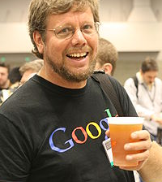
What’s Python
general purpose programming language conceived in 1989 by Dutch programmer Guido van Rossum (Google Alum, now at Dropbox)
name comes from Monty Python’s Flying Circus
free and open Source
community-based development
Supported by a vast collection of standard and external software libraries

Slide 5
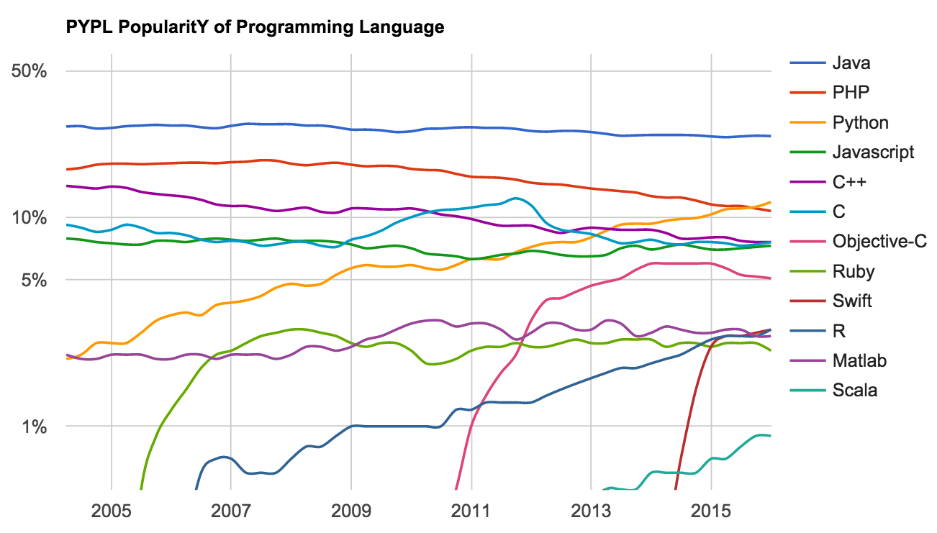
Popularity of Python

Slide 6
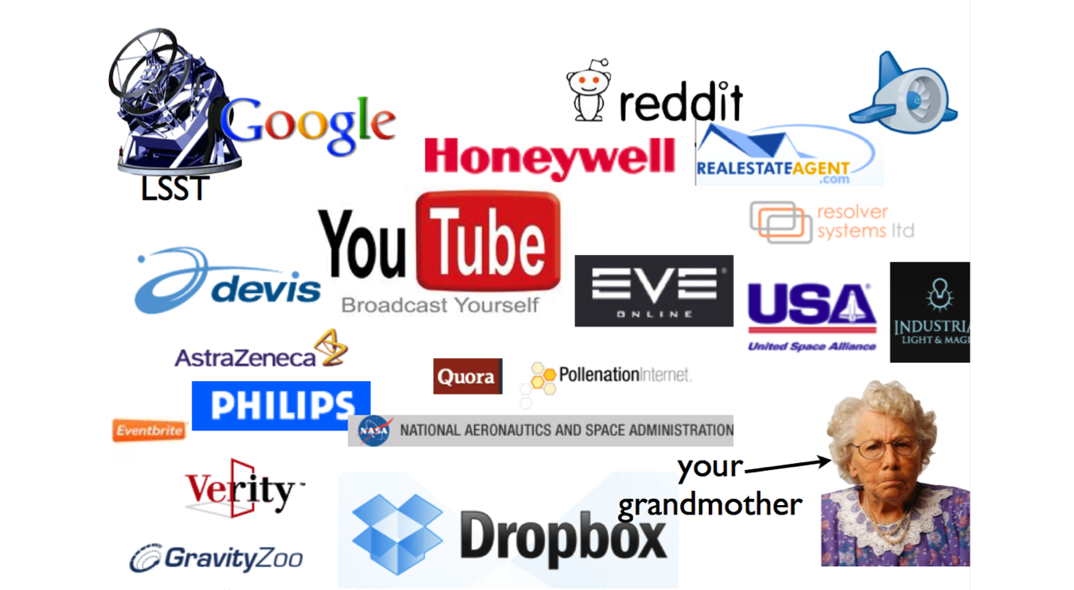
Who uses Python?

Slide 7
Common Uses (Packages)
Scientific Computation – scipy, numpy
Advanced Plotting and Data Visualization – matplotlib, mayavi
Machine Learning – scikit-learn
Timeseries Modelling - Pandas
Communications (Interacting with the world) – xml-rpc, urllib, serial
Web Development – Django
Database Interaction, Large Datasets – HDF5
CGI and GUIs – Tkinter, GTK, Traits
Parallelism
Multimedia, data processing, security, etc

Slide 8
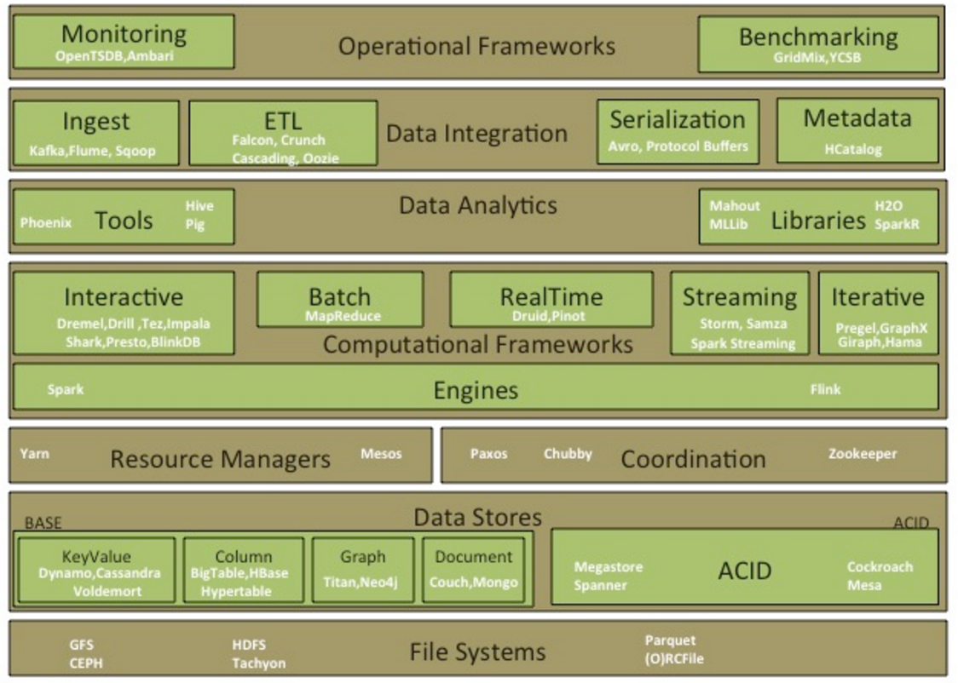
In the Grand Scheme of Things
Notes:
You can build a fine ETL pipeline or distributed system in python
But most tools are written on JVM and Java

Slide 9
How hard will this be?

Slide 10
How hard will this be?
Easier than you would expect

Slide 11
Coding Environment
Python
Fire up the interpreter and start coding
Ipython
A powerful interactive shell
A kernel for Jupyter
Support for interactive data visualization and use of GUI toolkits
Flexible, embeddable interpreters to load into projects
Easy to use, high performance tools for parallel computing
IDEs
Jupyter Notebook (Web Application built in the 2010 era)
Interactive
Reproducible: re-run portions of program, explore and test code in a modular fashion etc
Magic & auto-completion
Great for documentation
Supports more than 40 languages now (e.g. R, Julia, etc)
Notes:
Integrates program code execution, display of the results as e.g. graphic plots & document editing for normal text writing and formatting in a unified python notebook environment
https://www.quora.com/Python-programming-language-1/What-is-the-difference-between-IPython-notebook-and-IDLE

Slide 12
Next Steps
Download Anaconda
Completely free Python Distribution
300 Python Packages
https://www.continuum.io/downloads
Comes with pip
Install Ipython
Command: pip install ipython
Install JuPyter Notebook
Command: pip install jupyter notebook
To start the Notebook
Command: ipython notebook

Slide 13
How to learn Python (self-paced)
Python Bootcamp
Python Course 9H
Python Seminar (AY250)

Slide 14
Resources
Ipython Notebook Gallery
https://github.com/ipython/ipython/wiki/A-gallery-of-interesting-IPython-Notebooks
Preparing For Interviews
Leetcode: https://leetcode.com/
Competitions
Quantopia: https://www.quantopian.com/, etc

